Slide 1
Chemical Applications of Neutron Scattering: ISIS Neutron School 2022
Lots of examples centred on ‘adsorbed Layers’
Stuart Clarke
BP Institute, Department of Chemistry,
University of Cambridge, UK

Slide 2
Talk Outline
Neutron scattering
Coherent scattering - structure
Incoherent scattering - dynamics
Examples of surfaces / neutron applications:
Adsorbed layers:
In-plane structure – 2D diffraction (D20)
Out-of-plane structure – reflection (SURF, CRISP, INTER, POLREF, OFFSPEC)
What’s adsorbed? (IQNS - dynamics) IRIS
Colloidal dispersions (dominated by surfaces)
What’s on the surface? SANS (LOQ)
What arrangement ? SE- SANS
Liquid structure PDF (SANDALS, NIMROD)
Conclusions
We use LOTS of different techniques to answer complex problems
Too much to cover…. See how far we get..
Notes:
Mid ground between materials chemistry, physical theory, physical characterisation, engineering etc..

Slide 3
Conclusions
Neutrons
Very powerful tool(s) for Structure (Dynamics)
Contrast between H and D very useful: highlight
Can ‘see’ Hydrogen: Highlight
- Excellent transmission (extreme/commerical conditions)
BUT.
- Tricky to get hold of/limited access
(complement with other methods)
Notes:
Mid ground between materials chemistry, physical theory, physical characterisation, engineering etc..

Slide 4
Examples of Monolayers
Wetting
Notes:
Adsorption to solid
PAUSE!!
Adsorbed layers central to many phenomena:
Motivation.
Dyes used to enhavnce spectral range of PV’s, patterning
Adsorbed surfacts for coloidal stability
Detergency synergy multicomponent mixture
In many cases ordered layers crucial:
Boundary lubrication
wetting behaviour:condensing vapour onto surface
Orderd layers can inhibit complete wetting
structual missmatch.
Particularly solid monolayers!!!
Other places interfaces crucial: Types of wetting-I, II, III?
Even strongly attractive surfaces can show
incomplete wetting due to formation of
solid/crystalline layers-lattice mismatch
Ordered layers very important in boundary lubrication.
Liquid crystal alignment etc.
Advanced from mere speculation about the existence of solid monolayers to subtle details of crystal packing.

Slide 5
Talk Outline
Examples of surfaces / neutron applications:
Adsorbed layers:
In-plane structure – 2D diffraction
Out-of-plane structure – reflection
What’s adsorbed? (IQNS - dynamics)
Colloidal dispersions (dominated by surfaces)
What’s on the surface? SANS
What arrangement ? SE- SANS
Liquid structure PDF (NIMROD)
Notes:
Mid ground between materials chemistry, physical theory, physical characterisation, engineering etc..

Slide 6
3D diffraction: crystallography
‘Work horse’ of chemical community
Crystal structures of minerals, materials, organic molecular structure determination.
Neutrons very good at hydrogen (x-rays no so good)
Adjacent elements (look the same to x-rays)
TODAY: 3D ➔ 2D diffraction

Slide 7
In-plane 2D Structure:
X-ray and Neutron diffraction
Less
Equals
Decane on graphite
Octane on graphite
Neutrons: sensitive to hydrogen
X-rays: greater precision
Independent information
Combination is often essential

Slide 8
Why Xrays AND neutrons are important.

Slide 9
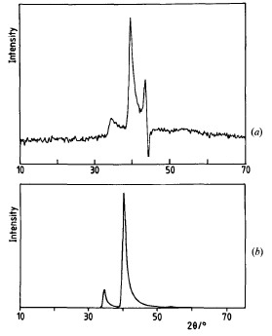
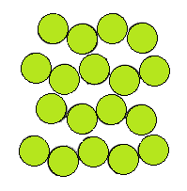
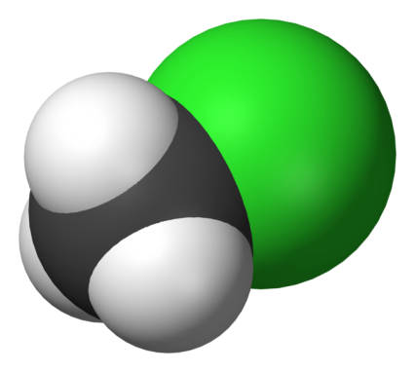
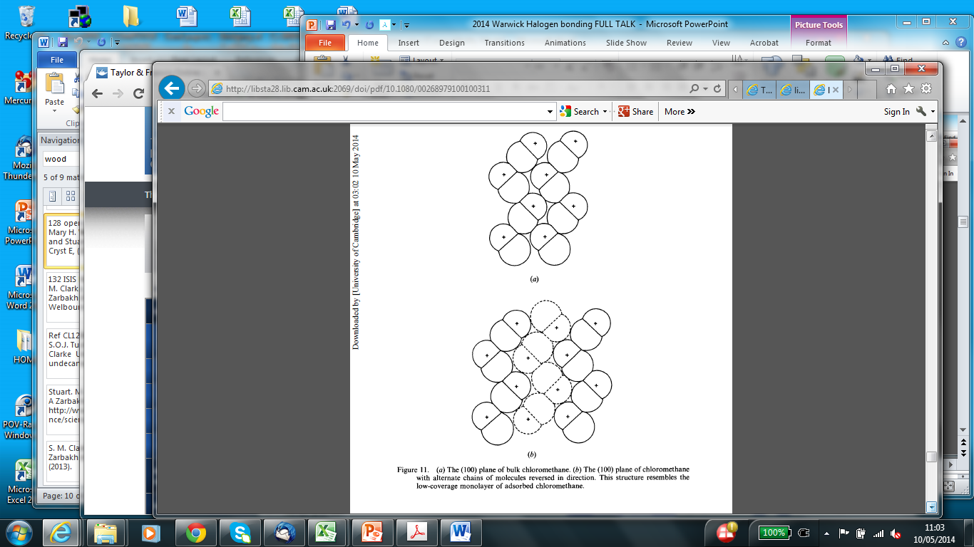
Chloromethane monolayer: X-rays
Low coverage
X-ray
Chlorine atoms
Where are CH₃ groups?
Guessed:
Ferro electric ordering?
Like bulk crystal plane…
Bulk Plane
Morishige, et al., Mol Phys , 72 395-411 (1991). 'The Structure of Chloromethane Monolayers Adsorbed on Graphite'.

Slide 10
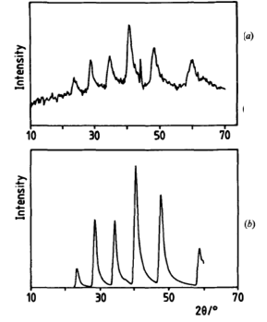
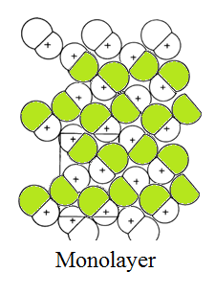
Chloromethane
Low coverage
X-ray
Neutron
With neutrons:
Anti ferroelectric
Alternating chains
Bulk Plane
Monolayer
Morishige, et al., Mol Phys , 72 395-411 (1991). 'The Structure of Chloromethane Monolayers Adsorbed on Graphite'.
Need neutrons to see CH₃ groups and full symmetry

Slide 11

Mixing: How do you tell if two species like each other?
1) They avoid each other ➔ phase separation:

Slide 12

Mixing ideally

Slide 13

Special relationship; stoichiometric complex Molecular compound

Slide 14
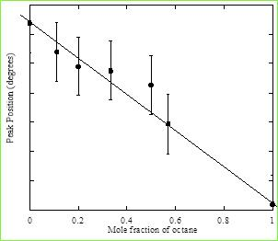
Structure: Diffraction from Mixed Monolayers
How do molecules mix on a surface?
Pure A
Pure A
Molecular Compound
Pure B
Pure B
Intensity →
Composition →
Angle →
(a) Phase sep. (b) Mixing (c) Molecular compound
Pure C9OH
Pure C7OH
Heptanol/nonanol
Heptanol/octanol
Hexanol/heptanol

Slide 15
‘Special, non-covalent bonding between molecules’
Big topic of supramolecular self assembly
Donation of lone pair from nitrogen to Iodine ataom

Slide 16
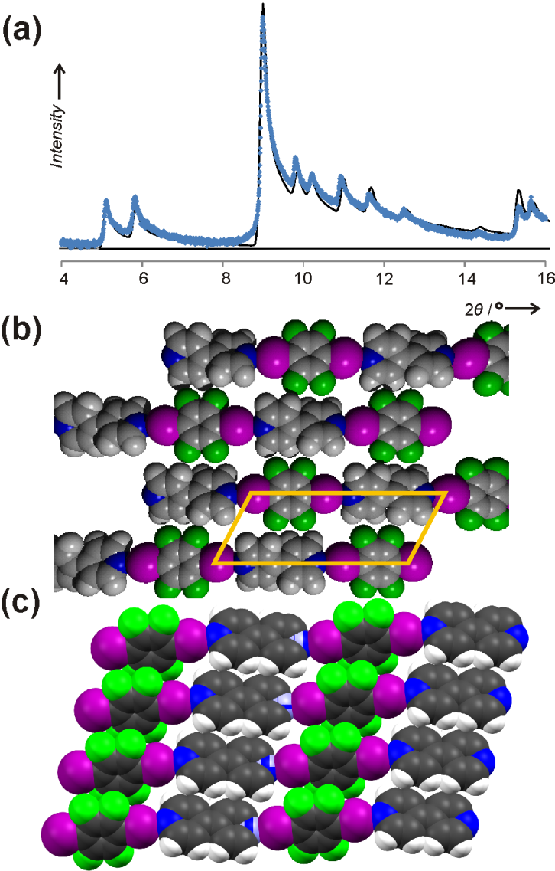
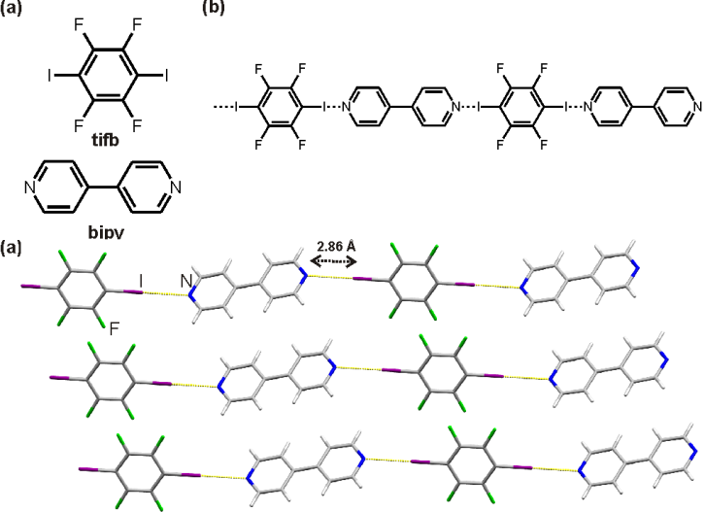
Novel Chemical interactions: Halogen Bonded co-crystal
N….I-C
Monolayer
‘New hydrogen bonds’
Very stable layers
^{2D}T>> ^{3D}T
Directional
Strong
‘Controls’ strength
and orientation

Slide 17
2D –diffraction: summary
Can see in-plane molecular structure.
(non-invasive)
X - ray and neutrons can be essential : Neutrons ‘see’ H
Determine surface phase behaviour
Characterise inter molecular bonding

Slide 18
Talk Outline
Examples of surfaces / neutron applications:
Adsorbed layers:
In-plane structure – 2D diffraction
Out-of-plane structure – reflection
What’s adsorbed? (IQNS - dynamics)
Colloidal dispersions (dominated by surfaces)
What’s on the surface? SANS
What arrangement ? SE- SANS
Liquid structure PDF (NIMROD)
Notes:
Mid ground between materials chemistry, physical theory, physical characterisation, engineering etc..

Slide 19
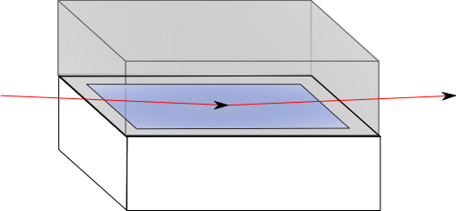

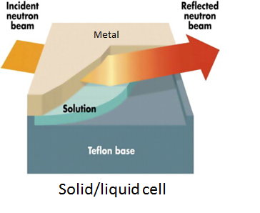
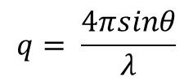
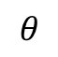
Neutron Reflection: how does it work?
Reflection of neutrons from the
solid/liquid interface at grazing
angles
Collect reflected intensity as a function of ‘angle’ (q)..
Solid substrates and coated surfaces
Extend to new solid/liquid Interfaces: iron oxides, stainless, alumina, Ti oxides, Ni, Cu …
(previously: silica, Al₂O₃)
New conditions:
applied shear
$$θ$$
$$q= \frac{4πsinθ}{λ}$$

Slide 20
Neutron Reflection Theory

Slide 21
Neutron Reflection Theory

Slide 22
Neutron Reflection Theory

Slide 23
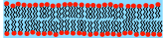
Neutron Reflection Theory
BIO:
Supported bilayers key theme of recent bio- studies
Representing biomembranes…
(with proteins etc.)
Film thickness
Position of critical edge key indicator of solution composition
(Tutorial problem)
‘Fit’ experimental data to model.
➔ How much material at the surface
Layer ‘structure’
Non-invasive/in-situ
Substrate
Layer thickness
Liquid

Slide 24
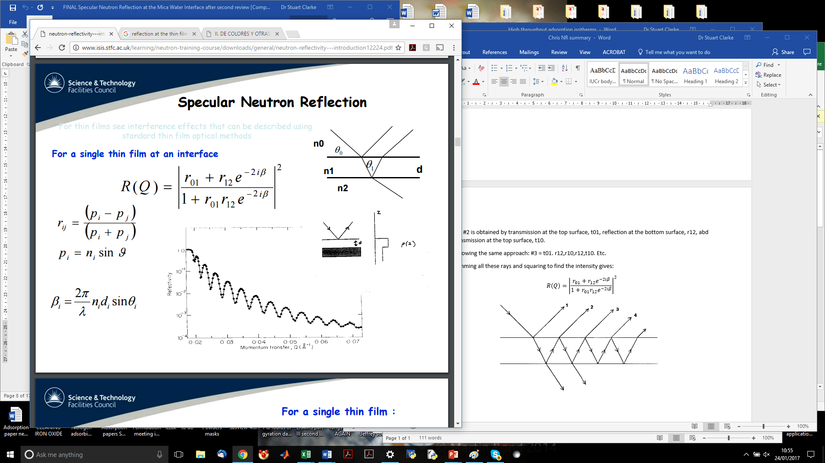
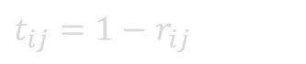
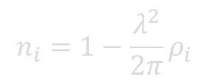
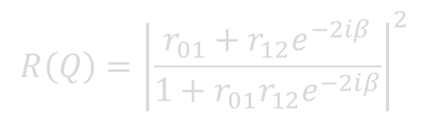
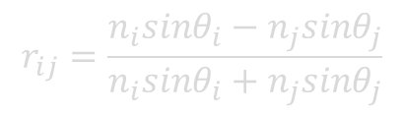
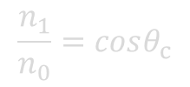
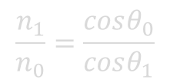
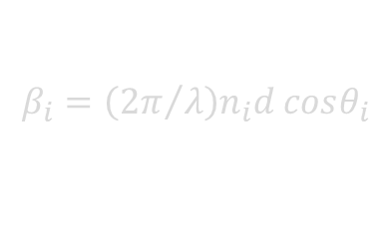
Thin layer reflection: Add amplitudes
$$\frac{n_{1}}{n_{0}}=\frac{cosθ_{0}}{cosθ_{1}}$$
$$\frac{n_{1}}{n_{0}}=cosθ_{c}$$
Tutorial problem: geometric series
$$r_{ij}=\frac{n_{i}sinθ_{i}−n_{j}sinθ_{j}}{n_{i}sinθ_{i}+n_{j}sinθ_{j}}$$
$t_{ij}=1−r_{ij}$
$$R\left(Q\right)={\left|\frac{r_{01}+r_{12}e^{−2iβ}}{1+{r_{01}r}_{12}e^{−2iβ}}\right|}^{2}$$
$$n_{i}=1−\frac{λ^{2}}{2π}ρ_{i}$$
$$β_{i}=\left({2π}/λ\right)n_{i}d cosθ_{i}$$

Slide 25
Neutron: ‘Magic’
Contrast matching..
Making things disappear!
Unique structural solution.
➔ BIG advantage of neutrons
Need to make sure complete exchange of solutions.. Not always easy..
Ask me about ‘baby oil’?
BUT: bio-molecules very complicated/hard to prepare.
(dedicated facilities at some Institutes)

Slide 26

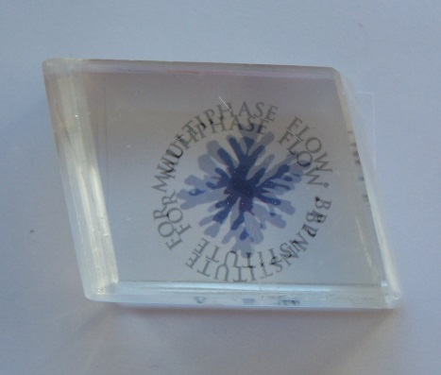
Reflection Example #1
Calcite (CaCO3)
Very important mineral
Scale in your kettle
Oil reservoirs
Overbasing agent in engines
What adsorbs and how?
In oil? In water?
Polymers? Surfactants?
(Birefringent…! Double refraction)

Slide 27
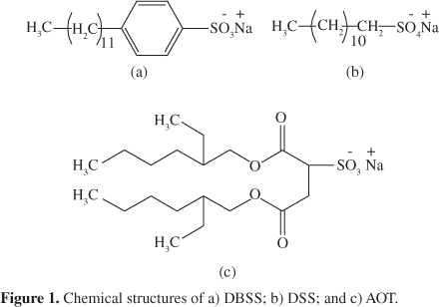
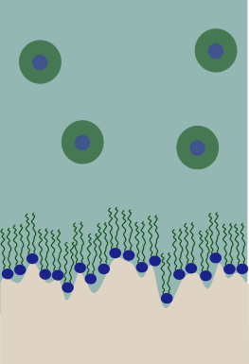
Neutron reflection: Example #1 Surfactant, AOT, on Calcite (CaCO3) in oil
Why a monolayer adsorb in oil and not a bilayer?
Adsorption of a monolayer on a surface:
(The bare surface, monolayer and bilayer calculations)
What adsorbs in water…..?

Slide 28
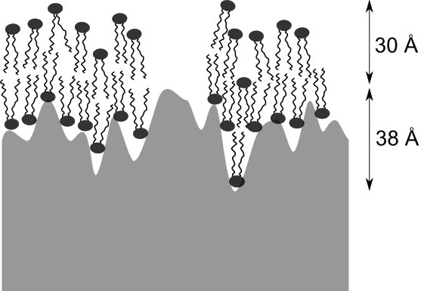
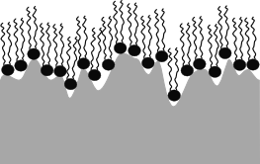
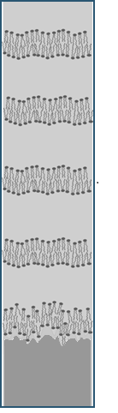
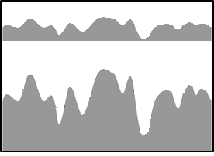
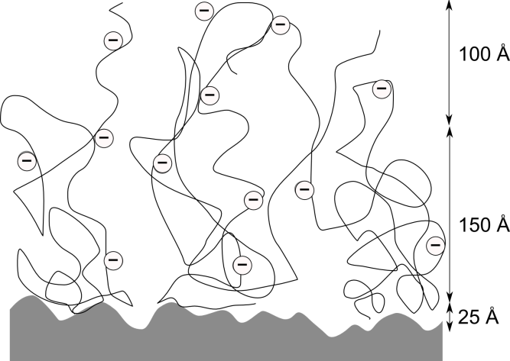
Reflection Example : Additives on calcite..
Monolayers, Bilayers,
multilayers and adsorbed polymers
Surface corrosion
Molecular precision!
Notes:
Mention other interesting challenges we can address: fatty acids, more detailed AOT from oil, asphaltenes and resins; also other mineral surfaces: Si in progress, any other one where we get good crystals

Slide 29
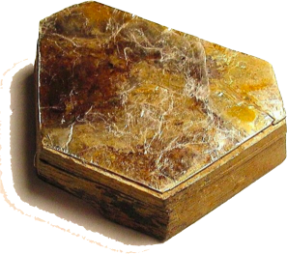
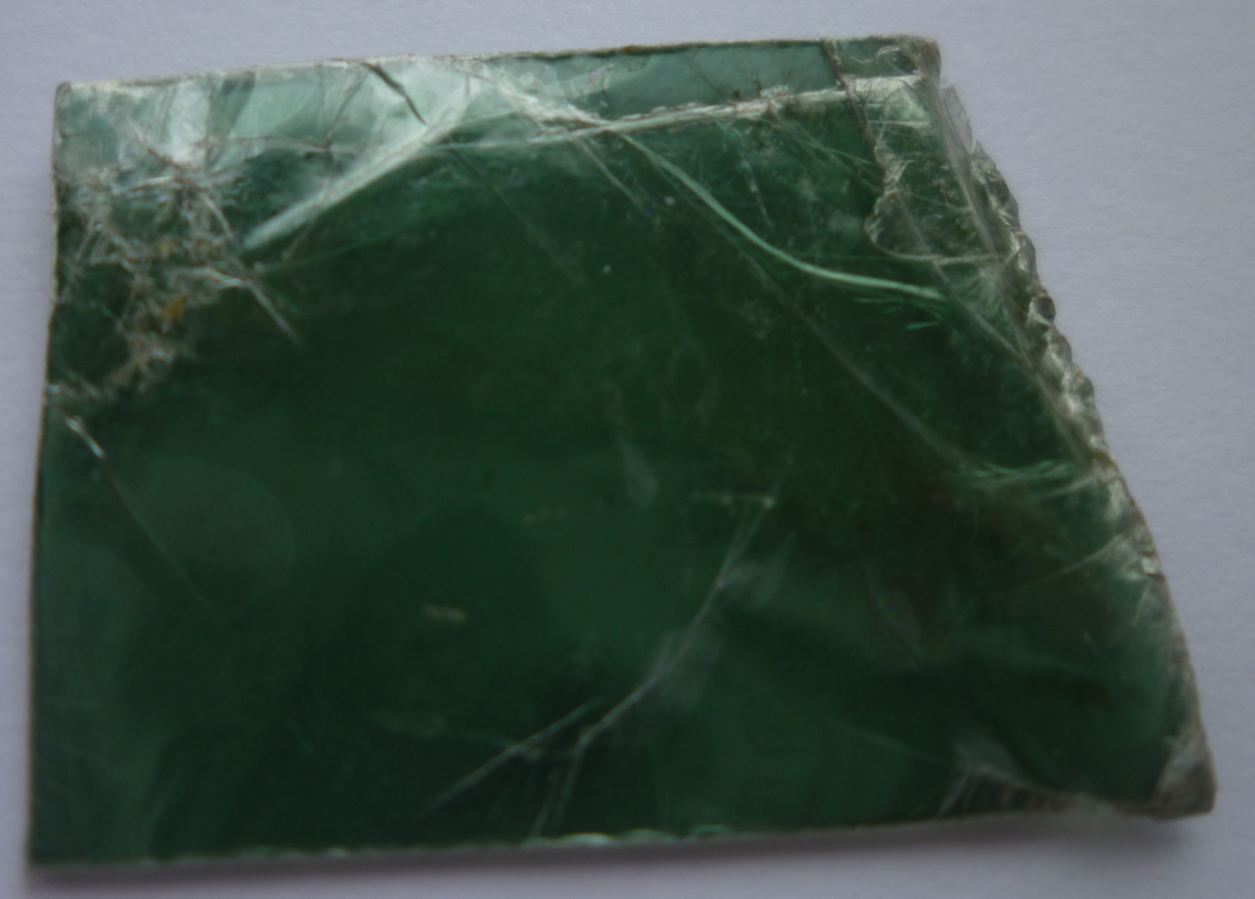
(Kate Miller) Layered silicate: mineral books
Reflection Example : Mineral Surfaces - mica
Mica:
Clays are key component of many oil reserviors
Very common in AFM/SFA studies
Many attempts to study with neutron reflection failed
To hard to get a beam through
Can’t deposit through vapour
Thin sheets too flexible/break.. So..?

Slide 30
‘Peeling’ Mica
Mica
‘Glue’
silicon
Support very thin layers on solid substrate and ‘peel’
Does it work?.......
Can we see adsorption on mica in solution?…

Slide 31
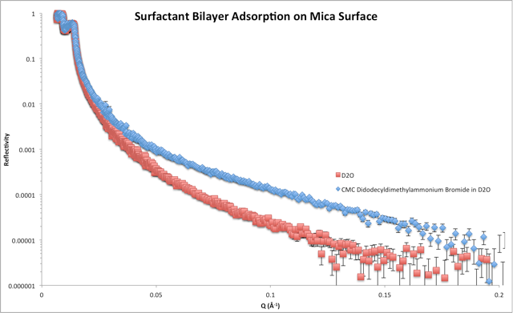
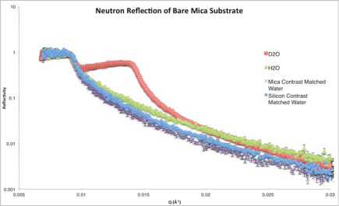
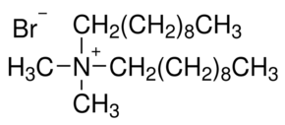
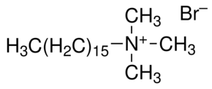
Surfactant adsorption on mica
Rather thick layers of glue and Mica – does this change the reflection?
(‘Advanced’ tutorial problem)
Neutrons
Mica
Surfactant bilayer
Non-invasive:
(a) DiDoDAB: Complete bilayer
(same result as AFM)
(b) CTAB: NOT same as AFM
Neutrons non-invasive
AFM

Slide 32
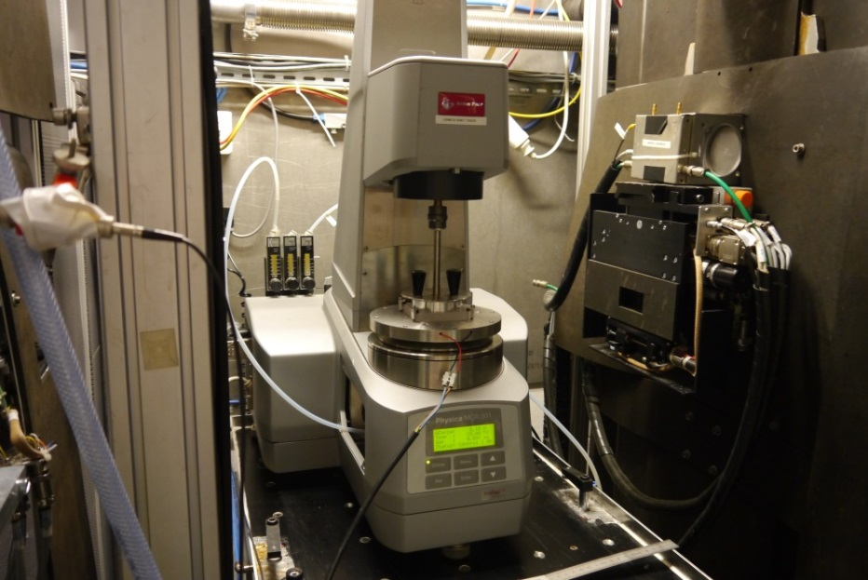
Example: Layers under Shear
Do layers get swept off under shear?
(steady and oscillatory shear)
Modest shear rates < 500s⁻¹
(pipe flow, or flow over rock-beds)

Slide 33
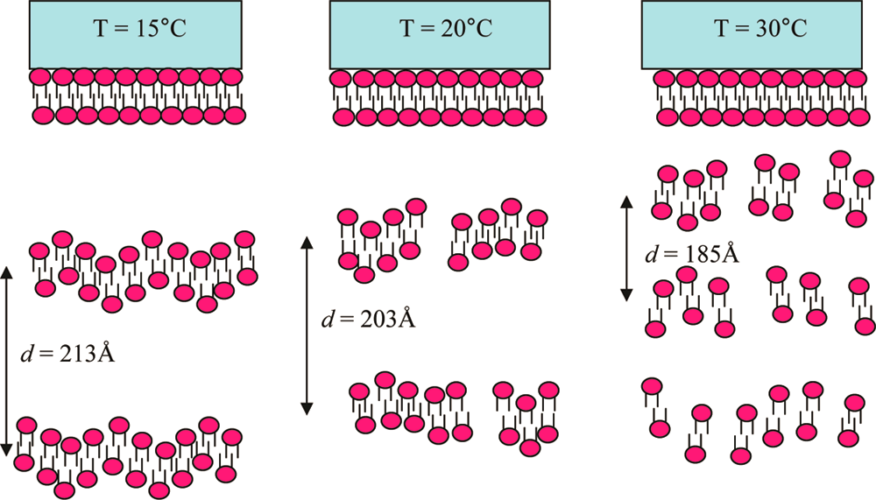
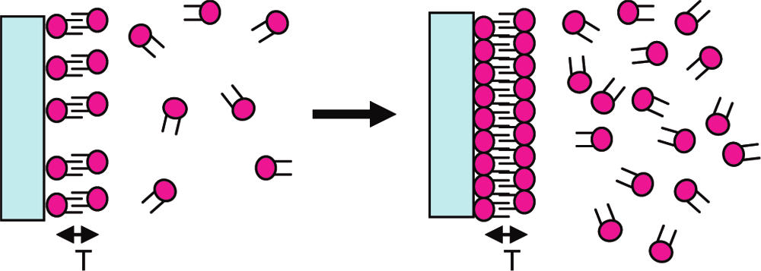
Shear/Flow:
AOT on Alumina/water
Thick layers
Thin layers

Slide 34
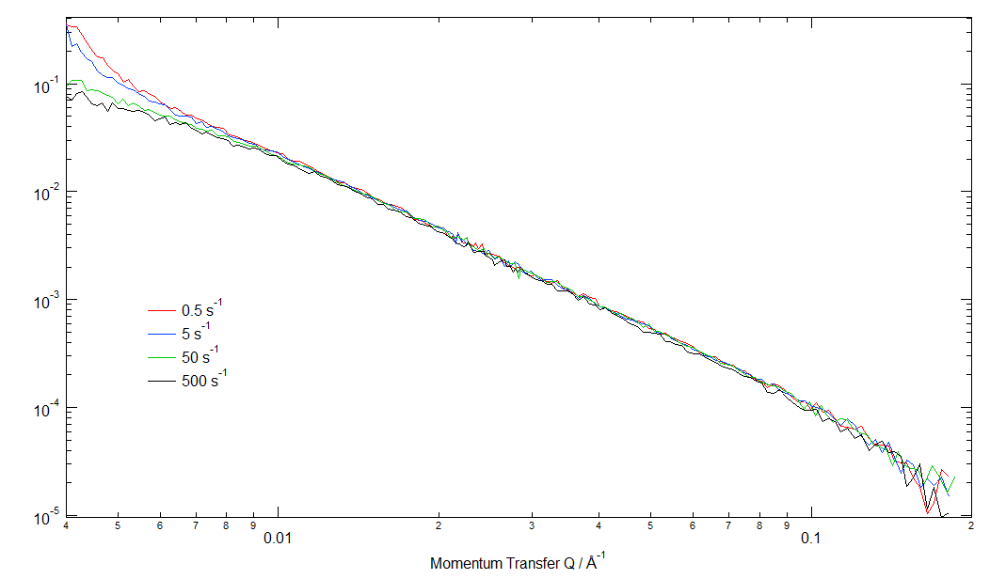
Effects of Shear: neutron reflection:
Thin layer
Neutron reflection data: D17
SURFACTANT BILAYER (thin layer approx. 30A thick)
Data: under steady shear increasing to approx 1000s⁻¹:
Shear has no effect
on thin layer
Very thin layer - too thin for significant shear effects.
(Same result under oscillatory shear).

Slide 35
Effects of Shear: neutron reflection:
Thick layer
Shear has big effect
on thick layers
Adsorbed multi layer
Thick layer!!
Under steady and oscillatory shear: ➔ BIG effects
Critical shear rate that delaminate the layers
Higher shear rates planned

Slide 36
Talk Outline
Examples of surfaces / neutron applications:
Adsorbed layers:
In-plane structure – 2D diffraction
Out-of-plane structure – reflection
What’s adsorbed? (IQNS - dynamics)
Colloidal dispersions (dominated by surfaces)
What’s on the surface? SANS
What arrangement ? SE- SANS
Liquid structure PDF (NIMROD)
Notes:
Mid ground between materials chemistry, physical theory, physical characterisation, engineering etc..

Slide 37
Quasi-elastic neutron scattering
Diffusive motions
How long to move out of your ‘box’

Slide 38
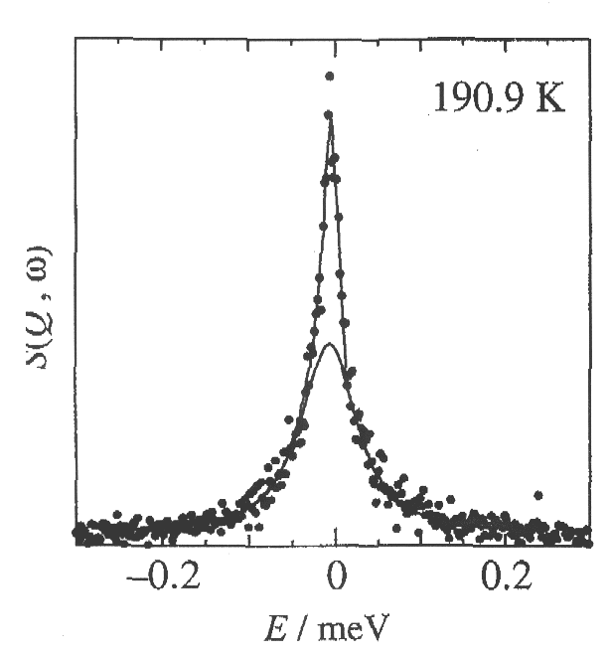
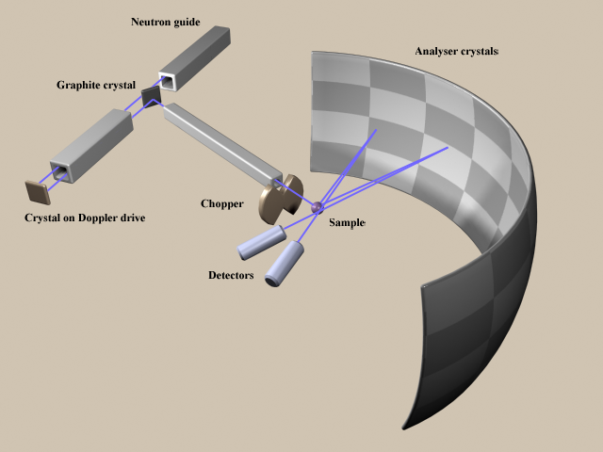
Incoherent Neutron Scattering
Actually get a distribution of scattered neutron energies:
Details of the angular dependence of the scattering can inform us about molecular motions
Intensity
ΔE
Very high energy resolution, 1 μeV
IN10/IN16/IRIS

Slide 39
Hydrogen and Deuterium are different
Hydrogen – very strong scatterer
Deuterium – weak scatterer
In a mixture can use neutrons to choose what we ‘see’

Slide 40
Quasi-elastic Incoherent Neutron Scattering (IQNS) – ‘Dynamics’
Isotopic substitution to distinguish components (H>>D)
Dynamics to differentiate adsorbed from non-adsorbed materials
Neutrons can exchange energy with sample nuclei:
Sample
‘Elastic’
Static
Solids
Slowed down
Speeded up
Translating nuclei
‘Inelastic’
Liquids
Intensity of elastic scattering ➔ Amount of adsorbed, ‘NOT-MOVING’ material

Slide 41
Adsorbed Molecules are different
Monolayer
(solid)
Bulk
(liquid)
Adsorbed layers are ‘static’
surface
Liquids are ‘dynamic’
Use mobility to distinguish adsorbed layers

Slide 42
‘IQNS’ What’s adsorbed?
Monolayer
(solid)
Bulk
(liquid)
surface
Only ‘see’ protonated bits
Component of interest (protonated)
Other component(s) (deuterated)
‘Elastic’ scattering
Only ‘see’ contribution from component of interest in the monolayer

Slide 43
Incoherent quasi-elastic neutron scattering (IQNS)
What do we expect to see if there is a solid
monolayer coexisting with the bulk liquid?

Slide 44
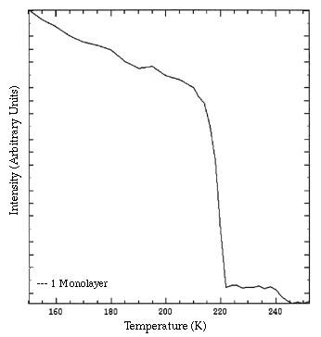
IQNS Results: Octane on Graphite
Bulk melting point
How much is in this monolayer?
(Tutorial Problem)
Monolayer melting point
Monolayer Level

Slide 45
What’s adsorbed: (IQNS) Results from mixtures
Monolayer composition as a
function of solution composition
Plateau level falls as octane
is displaced by decane
Octane/nonane
Octane/decane

Slide 46
Dynamics of Adsorbed Layers
Distinguish solid from liquid
elastic scattering
Diffusion coefficient of liquid layers
Width of the quasi-elastic peak
Rotation of molecules
q-dependence of the elastic scattering
Mark Johnson

Slide 47
Talk Outline
Examples of surfaces / neutron applications:
Adsorbed layers:
In-plane structure – 2D diffraction
Out-of-plane structure – reflection
What’s adsorbed? (IQNS - dynamics)
Colloidal dispersions (dominated by surfaces)
What’s on the surface? SANS
What arrangement ? SE- SANS
Liquid structure PDF (NIMROD)
Notes:
Mid ground between materials chemistry, physical theory, physical characterisation, engineering etc..

Slide 48
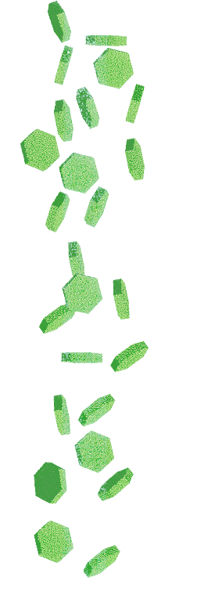
What are Colloids?
‘nanoparticles’
Want to know
What shape are the separate colloids
What orientation
What arrangement
Soft-matter: SANS a key approach:
Characterisation of polymers/emulsions/gels
Tiny objects (10 nm – 10 μm)
Dispersed in a continuous phase
Examples (lots…) Fog – water droplets in air
Blood – particles in ‘water’
Milk – liquid fat drops in water (emulsion)
Foam – air bubbles in a liquid or solid
Important flow properties
Need to ‘look’ through metal cells
Opaque samples
Neutron Transmission
Spheres
Plates

Slide 49
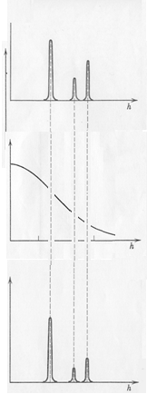
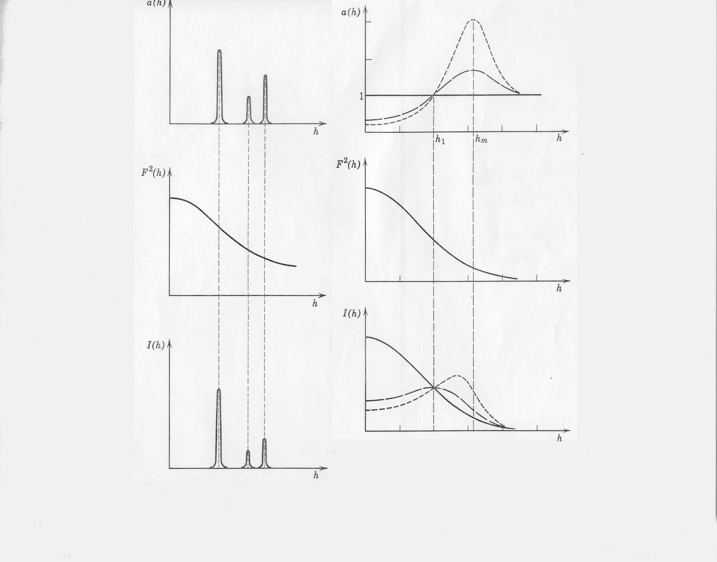
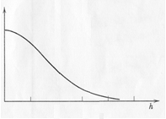
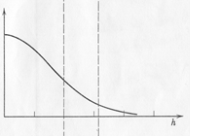
Form and Structure Factors
I(Q)=P(Q)S(Q)
Dilute Spheres
Crystal
Liquid
S(q)
S(q)
S(q)
P(q)
P(q)
P(q)
P(q)
I(q)
I(q)
I(q)
I(q)
q
‘Liquid’ ring
Diffraction peaks
Characterise particles

Slide 50
SANS: single colloid scattering (Dilute) What’s on the surface

Slide 51
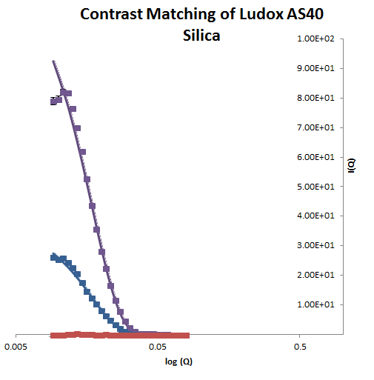
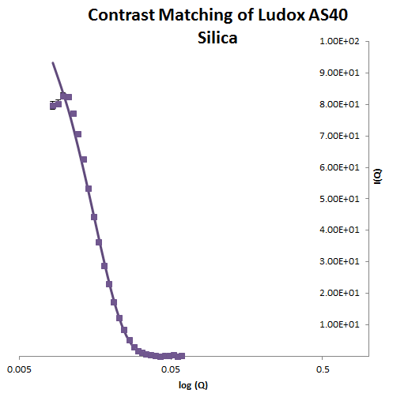

Mixtures: Contrast matching: ‘magic’
Scattering from silica in water: Mixtures of H₂O and D₂O
Change scattering of water
(refractive index = ‘colour’):
silica –disappears
‘See’ each component of a mixture separately
Simplify complex systems

Slide 52
Small Angle Scattering: - P(Q)
Dilute core-shell particles
Thin water layer on calcite colloids in oil
P(Q) form factor for core-shell more complex
Structure: core/water/surfactant/oil
D/H-cyclohexane
8.8 Ǻ
26.3 Ǻ
CaCO₃
2.7 Ǻ
H₂O
‘Contrast variation’
H₂O and D₂O mixtures
change ‘colour’ of different bits
Surfactant sheath
Thanks to Richard Heenen and co

Slide 53

Contrast variation:
Enhance sensitivity to each bit by selective deuteration

Slide 54
IF TIME SANS: Single particle orientation
SANS of plate-like particles

Slide 55
SANS: single particles - orientation
Flow
Direction
Use crystalline nature of particles to obtain full three-dimensional orientational distribution function
When is the extent of orientational order?
Under flow?
With particle size?
Aspect ratio?
Concentration?
Completely random particle distribution => ‘powder’ ring
Perfectly aligned => single ‘spot’
Preferred orientation => ‘arc’ of intensity
Anisotropic Particles

Slide 56
Measuring orientational order of plates
Steady Flow
Only crystals in the correct orientation will diffract
Intensity gives number of crystals at each orientation in a sample
Orientational order of the plates in flow

Slide 57
Dense Clay pastes under static and cross-flow conditions

Slide 58

Two colour cars

Slide 59
END of EXTRA BIT

Slide 60
SANS: Interference Between Objects
Eg Colloidal dispersion
Consider scattering as distribution of spheres
Isolated object, e.g. spheres (P(Q))
S(Q) is called the interference or ‘structure factor’: interference from different colloids.
Measured intensity is:
I(Q)=P(Q) x S(Q)
Other systems:
Crystal - unit cells repeat on a regular lattice

Slide 61


Colloidal crystals of spheres
Diffract light … Gives ‘diffraction patterns’
➔ Use diffraction to give structure

Slide 62





Colloidal Spheres under flow
Flow
A
B
C
Gradient
Crystal
Perfectly ordered sequence
of perfect hexagonally ordered layers
‘Layers’
Perfect hexagonally ordered layers
Sliding over each other with many different positions
‘Strings’
Particles in lines
Increasing Shear Rate
‘Crystal’
‘Strings’
‘Sliding layers’
Charged stabilised
latex spheres 8%
Behaviour like ‘atoms’ only much larger scales and slower

Slide 63
S(Q): Scattering Patterns from Layered Systems
‘Scattering’ Space
Structure in the stacking sequence reflected in intensity variations along ‘Bragg rods’ ➔ 3D FCC
‘Real’ Space
Single Layer
Stacked Layers

Slide 64
IF – TIME
EXTRA BIT SE- SANS
TRICKY!!!!

Slide 65
SANS ➔ SE-SANS VERY BIG objects
Big objects are seen at small scattering angles (‘Reciprocal space’)
To see scattering by SANS at small angles need VERY tightly collimated beam: BUT THEN NO FLUX!!
Spin echo SANS ➔ Keep wide open beam and
Encode the scattering angle in the neutron spin!!
(VERY CLEVER IDEA THIS!!)

Slide 66

Spin Echo -SANS Encode scattering angle in the neutron polarisation
‘Un-winds’ in magnetic field
Polarised neutron beam
Gives an ‘echo’
Sample
Precesses in magnetic field
Anisotropic magnetic fields
Collect intensity as a function of ‘z’ (combination of field angle, wavelength etc)
(Precession usually in horizontal plane)
Andersson 2008

Slide 67
SE SANS technique: Basic approach
Beam polarised in and out
Polarisation rotates one way and then back
Depends upon time in the magnetic fields
If neutrons don’t change direction ➔ big echo
If neutrons change direction (funny shaped field) ➔ Weaker ‘echo’ or depolarised.
Spin echo to encodes the angle ( q’)
➔ Actually Measure:
Real space, density-density correlation function, G(z)

Slide 68
Example: Silica particles in polymer matrix Colloidal Crystal
J. Baumberg Samples:
Hexagonal layers of 200nm silica in polymer matrix, 0.47 volume fraction.
Layers oriented and regularly stacked
Volume fraction 0.47 silica spheres
Ordered by ‘bending’ process
Stacked in layers.

Slide 69

‘Ordered’ array of spheres: SE-SANS
Small z-sphere form
Long z- sphere packing fraction
Intermediate z- inter particle correlation
Larmor ➔ NEW INSTRUMENT
Core radius (big!): 90nm (good agreement)
Vol fract as z➔ ∞, 0.22 in reasonable agreement.
(iii) First correlation peak is less ordered than expected.
(iv) Higher order correlations of a true crystal are lost.
Clearly indicates significant positional disorder in the ‘crystal’.

Slide 70
End SE-SANS extra bit

Slide 71
Talk Outline
Examples of surfaces / neutron applications:
Adsorbed layers:
In-plane structure – 2D diffraction
Out-of-plane structure – reflection
What’s adsorbed? (IQNS - dynamics)
Colloidal dispersions (dominated by surfaces)
What’s on the surface? SANS
What arrangement ? SE- SANS
Liquid structure PDF (NIMROD)
Notes:
Mid ground between materials chemistry, physical theory, physical characterisation, engineering etc..

Slide 72
Can we ‘understand’ liquid structure?
No long range order: NO diffraction??
Oh dear!!
But still a lot of structure..

Slide 73
Radial distribution function
Liquid species

Slide 74
Radial distribution function
Liquid species
r
How many species in this shell at distance r from the central one: g(r)

Slide 75

Pair distribution function: g(r) (normalised)
‘Hard’ core…
Nearest neighbour shells..
…

Slide 76
Pair distribution function: g(r), FT of scattering data
Measured data (NIMROD)
g(r))
Fourier Transform

Slide 77


Can we ‘understand’ liquid structure? See all Atom-Atom distances
Separate different atom contributions by isotopic exchange (H and D):
a) First difference (big circles exchanged):
b) Second difference:
➔ ONLY solute-solute distances!!

Slide 78

PDF example: Acetonitrile
See correct molecular structure at short distances
Solvent shells at
Longer distances

Slide 79

Supercapacitors: Ions in acetonitrile
TPA Br in acetonitrile:
See ‘ion pairs’
Br-

Slide 80
Talk Outline
Neutron sources
Coherent scattering - structure
Incoherent scattering - dynamics
Examples of surfaces / neutron applications:
Adsorbed layers:
In-plane structure – 2D diffraction
Out-of-plane structure – reflection
What’s adsorbed? (IQNS - dynamics)
Colloidal dispersions (dominated by surfaces)
What’s on the surface? SANS
What arrangement ? SE- SANS
Liquid structure PDF (NIMROD)
Conclusions
Notes:
Mid ground between materials chemistry, physical theory, physical characterisation, engineering etc..

Slide 81

Thanks..
Adam Brewer Halogen bonding:
Kate Miller/Lucy Griffin/Seung Lee: Calcite and Mica
Beth Howe/ Becky Welbourne (Phoebe Allen): PDF
Tom Arnold (DIAMOND): Alkane diffraction

Slide 82


ILL/ISIS / KEK/ LLB/ Berlin..etc.
– neutron Time
DIAMOND/SLS – SAXS time
All the (Long suffering) beamline scientists
Thank YOU !

